Slide 1

AI/AN Exemption from the Individual Shared Responsibility Payment
National Indian Health Outreach and Education
(NIHOE) Initiative 2014-2015
Notes:
Welcome and thank you for joining us today.
First, we’d like to thank IHS for their partnership and support to produce and provide this PowerPoint presentation for the American Indian and Alaska Native Shareholders . And we would like thank our NIHOE Partner, The National Congress of American Indians for the invitation to present on this topic today. The purpose of this power point is meant to provide basic information about the Marketplace exemption waiver for American Indian and Alaska Native and other Individuals who are eligible to receive services from an Indian Health Care Provider and special provisions and unique opportunities for AI/AN under the Patient Protection and Affordable Care Act.

Slide 2
Course Outline
The Individual Mandate
Minimum Essential Coverage
Tax Penalty
Should I apply?
How to Claim an Exemption

Slide 3
The Individual Mandate

Slide 4
The Individual Mandate Overview
Beginning in 2014, The ACA requires all Americans to have health coverage that meets minimum essential coverage (MEC) standards. This is also known as the health insurance mandate. Individuals that do not have health coverage may have to pay a tax penalty or a “shared responsibility payment”. However, individuals without coverage may not have to pay a penalty if they apply and qualify for an exemption. Exemptions are granted by the Marketplace or the Internal Revenue Service (IRS) through the tax filing process.
Notes:
The Individual mandate is the provision of the Patient Protection and Affordable Care Act law that says that all Americans must have healthcare coverage, either through their employer, a private insurer, or a government program - or they will be fined.

Slide 5
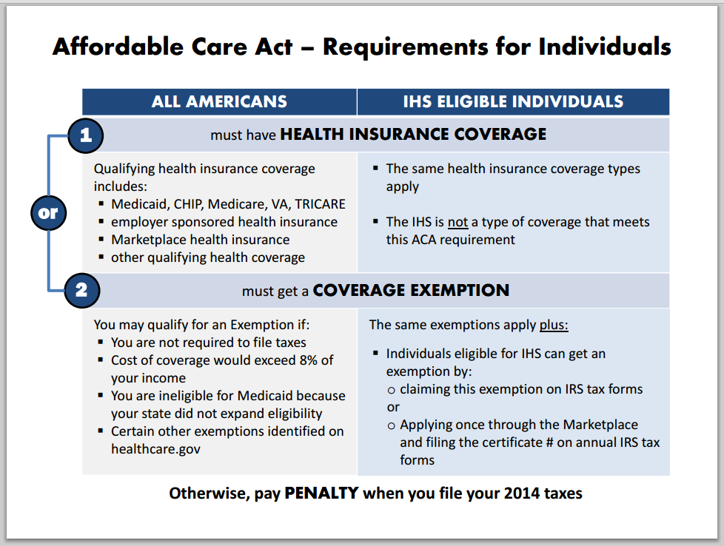
Notes:
On October 2, 2014 Dr. Roubideaux sent out a letter to Tribal Leaders informing them about the requirements of the Affordable Care Act Individual Mandate for all Americans and Individuals that are eligible for IHS, to have health insurance that meets minimum essential coverage by the end of 2014. Included in that letter was a diagram to illustrate how to meet ACA requirements or pay a penalty when you file your taxes for not having minimum essential coverage.

Slide 6
Special Provisions for AI/AN
Special monthly enrollment period
Zero and Limited Cost Sharing Plans
Exemption from individual shared responsibility payment (for not having minimum essential coverage)
Notes:
AI/AN have special provisions provided through the ACA including : Special enrollment periods. AI/AN can enroll in the marketplace during any time of the year. They may also be eligible for zero or limited cost sharing plans. Or an Marketplace Exemption can be filed for American Indians and Alaska Natives and Other Individuals who are Eligible to Receive Services from an Indian Health Care Provider.

Slide 7
MINIMUM ESSENTIAL COVERAGE
Notes:
Now let’s talk about the types of required minimum essential coverage needed to avoid the tax penalty or shared responsibility payment. We will also define what part of Medicare that qualifies as minimum essential coverage and what does not qualify.

Slide 8
Minimal Essential Coverage
Types of Minimum Essential Coverage
  Marketplace plans, often referred to as Qualified Health Plans or QHPs
  Medicaid, Medicare and CHIP
  Grandfathered individual health insurance plans
  Grandfathered retiree plans
  Employer Plans (this includes COBRA)
  TRICARE and other veterans health care programs such as CHAMPVA
  Coverage offered to students by universities for plans that begin on/before December 31, 2014

Slide 9
Minimal Essential Coverage
If you have Medicare Part A (Hospital Insurance)<http://www.medicare.gov/what-medicare-covers/part-a/what-part-a-covers.html>, you’re considered covered under the health care law and don’t need a Marketplace plan.
But having only Medicare Part B (Medical Insurance)<http://www.medicare.gov/what-medicare-covers/part-b/what-medicare-part-b-covers.html> alone doesn’t meet this requirement.

Slide 10
Minimal Essential Coverage
If you have only Medicare Part B, you are not considered to have minimum essential coverage<https://www.healthcare.gov/glossary/minimum-essential-coverage>. This means you may have to pay the penalty<https://www.healthcare.gov/fees-exemptions/> that people who don't have coverage may have to pay.
Notes:
If you only have Medicare Part B , remember you are not considered to have minimum essential coverage. This means you have to pay the penalty.

Slide 11
Minimal Essential Coverage (cont.)
HHS Secretary can designate other plans as those that meet Minimum Essential Coverage
Health coverage and plans that do not meet Minimum Essential Coverage Requirements
  IHS, Tribe or Tribal organization or Urban Indian health program/organization (I/T/U)
  Standalone dental plans
  Private plans that are not designated as a QHP or considered grandfathered
  Disease-specific coverage
Notes:
Important to note: If you use the I/T/U facility and do not have private Insurance you do not meet the minimum essential coverage mandate. You can continue to use those I/T/U services but you will also have to file an Exemption waiver to avoid paying a shared responsibility payment or tax penalty.

Slide 13
THE TAX PENALTY
Or (Individual Shared
Responsibility Payment)

Slide 14
Tax Penalty
Beginning on January 1, 2014, all Americans are required to maintain minimum essential coverage or pay a penalty.
Fines are due on the income tax filing date the following year
The penalty is broken out for each month that an individual does not meet the coverage requirements
2014
  The greater of either 1% of yearly household income or $95 per individual and $47.50 per child
Notes:
Listed here are the tax penalties that will be incurred on a yearly basis for individuals that do not maintain Minimum Essential health Coverage .

Slide 15
Tax Penalty (cont.)
2015
  The greater of either 2% of the yearly household income or $325 per individual and $162.50 per child
2016
  The greater of either 2.5% of the yearly household income or $695 per individual and $347.50 per child
2017 and moving forward
  The greater of either 2.5% of the yearly household income or the 2016 penalty per individual and child adjusted for inflation
Notes:
As you can see by the year 2017 there can be a substantial increase in the penalties.

Slide 16
SHOULD I Apply ?

Slide 17
Who Should Obtain an Exemption
All eligible American Indians and Alaska Natives and other Individuals who are eligible to receive services from an Indian health care provider
  Remember services at an I/T/U is not considered “minimum essential” coverage
Exemptions are specific to an “individual” not tied to households
Minimum essential coverage requirement is not determined by age (no age limit!)
  Infants need to obtain an exemption if they need to be exempt
Notes:
American Indians and Alaska Natives and Other Individuals who are Eligible to Receive Services from an Indian Health Care Provider are encouraged to file the exemption waiver .

Slide 18
How to claim an exemption

Slide 19
Two Ways to Claim the Exemption
Tax Return Filing Process
2. Marketplace Exemption Application

Slide 20
First Option-- Claim it on Tax Return
Both enrolled members of federally recognized Tribes and ANCSA Corporations AND individuals eligible for I/T/U services may claim the exemption when they file their 2014 Tax Return (due 4/15/15).
  HHS Secretary Sylvia Burwell announced on September 18, 2014 that individuals eligible to receive health care from an I/T/U will be able to claim an exemption from the shared responsibility payment through the tax filing process starting in 2014 tax year.
Notes:
On Tuesday Sept. 18 , 2014 the HHS Secretary Sylvia Burwell announced that individuals that are eligible to receive services through an Indian Health Service Facility were also available to file their exemption through the tax filing process . Prior to that announcement only members of federally recognized Tribes had an option to file an Exemption Waiver through the Marketplace or the Tax filing process. Now individuals have the availability of the tax filing process to apply for the Indian health care exemption which will save time and reduce duplication of effort.

Slide 21
Claim it on Tax Return (cont.)
IRS Tax Form 8965-Health Coverage Exemptions:
  Must complete this form when filing tax return if you have a Marketplace-granted coverage exemption or if claiming an exemption on your return.
  Can claim exemption in:
    Part I: If have an exemption certificate number, insert name and SSN of each individual; or
    Part II: If eligible for specific income exemptions; or
    Part III: If no exemption certificate number, self-attest and claim a specific exemption (i.e., must indicate type).

Slide 22
IRS Exemptions
For a coverage exemption that you qualify to claim on your tax return, all you need to do is file Form 8965 with your tax return – you do not need to call the IRS or obtain the exemption in advance.
You will use Part II, Coverage Exemptions for Your Household Claimed on Your Return, of Form 8965 to claim a coverage exemption if your income is below your filing threshold and you choose to file a tax return. If you are not required to file a tax return and don’t want to file a return, you do not need to file a return solely to claim this exemption.

Slide 23
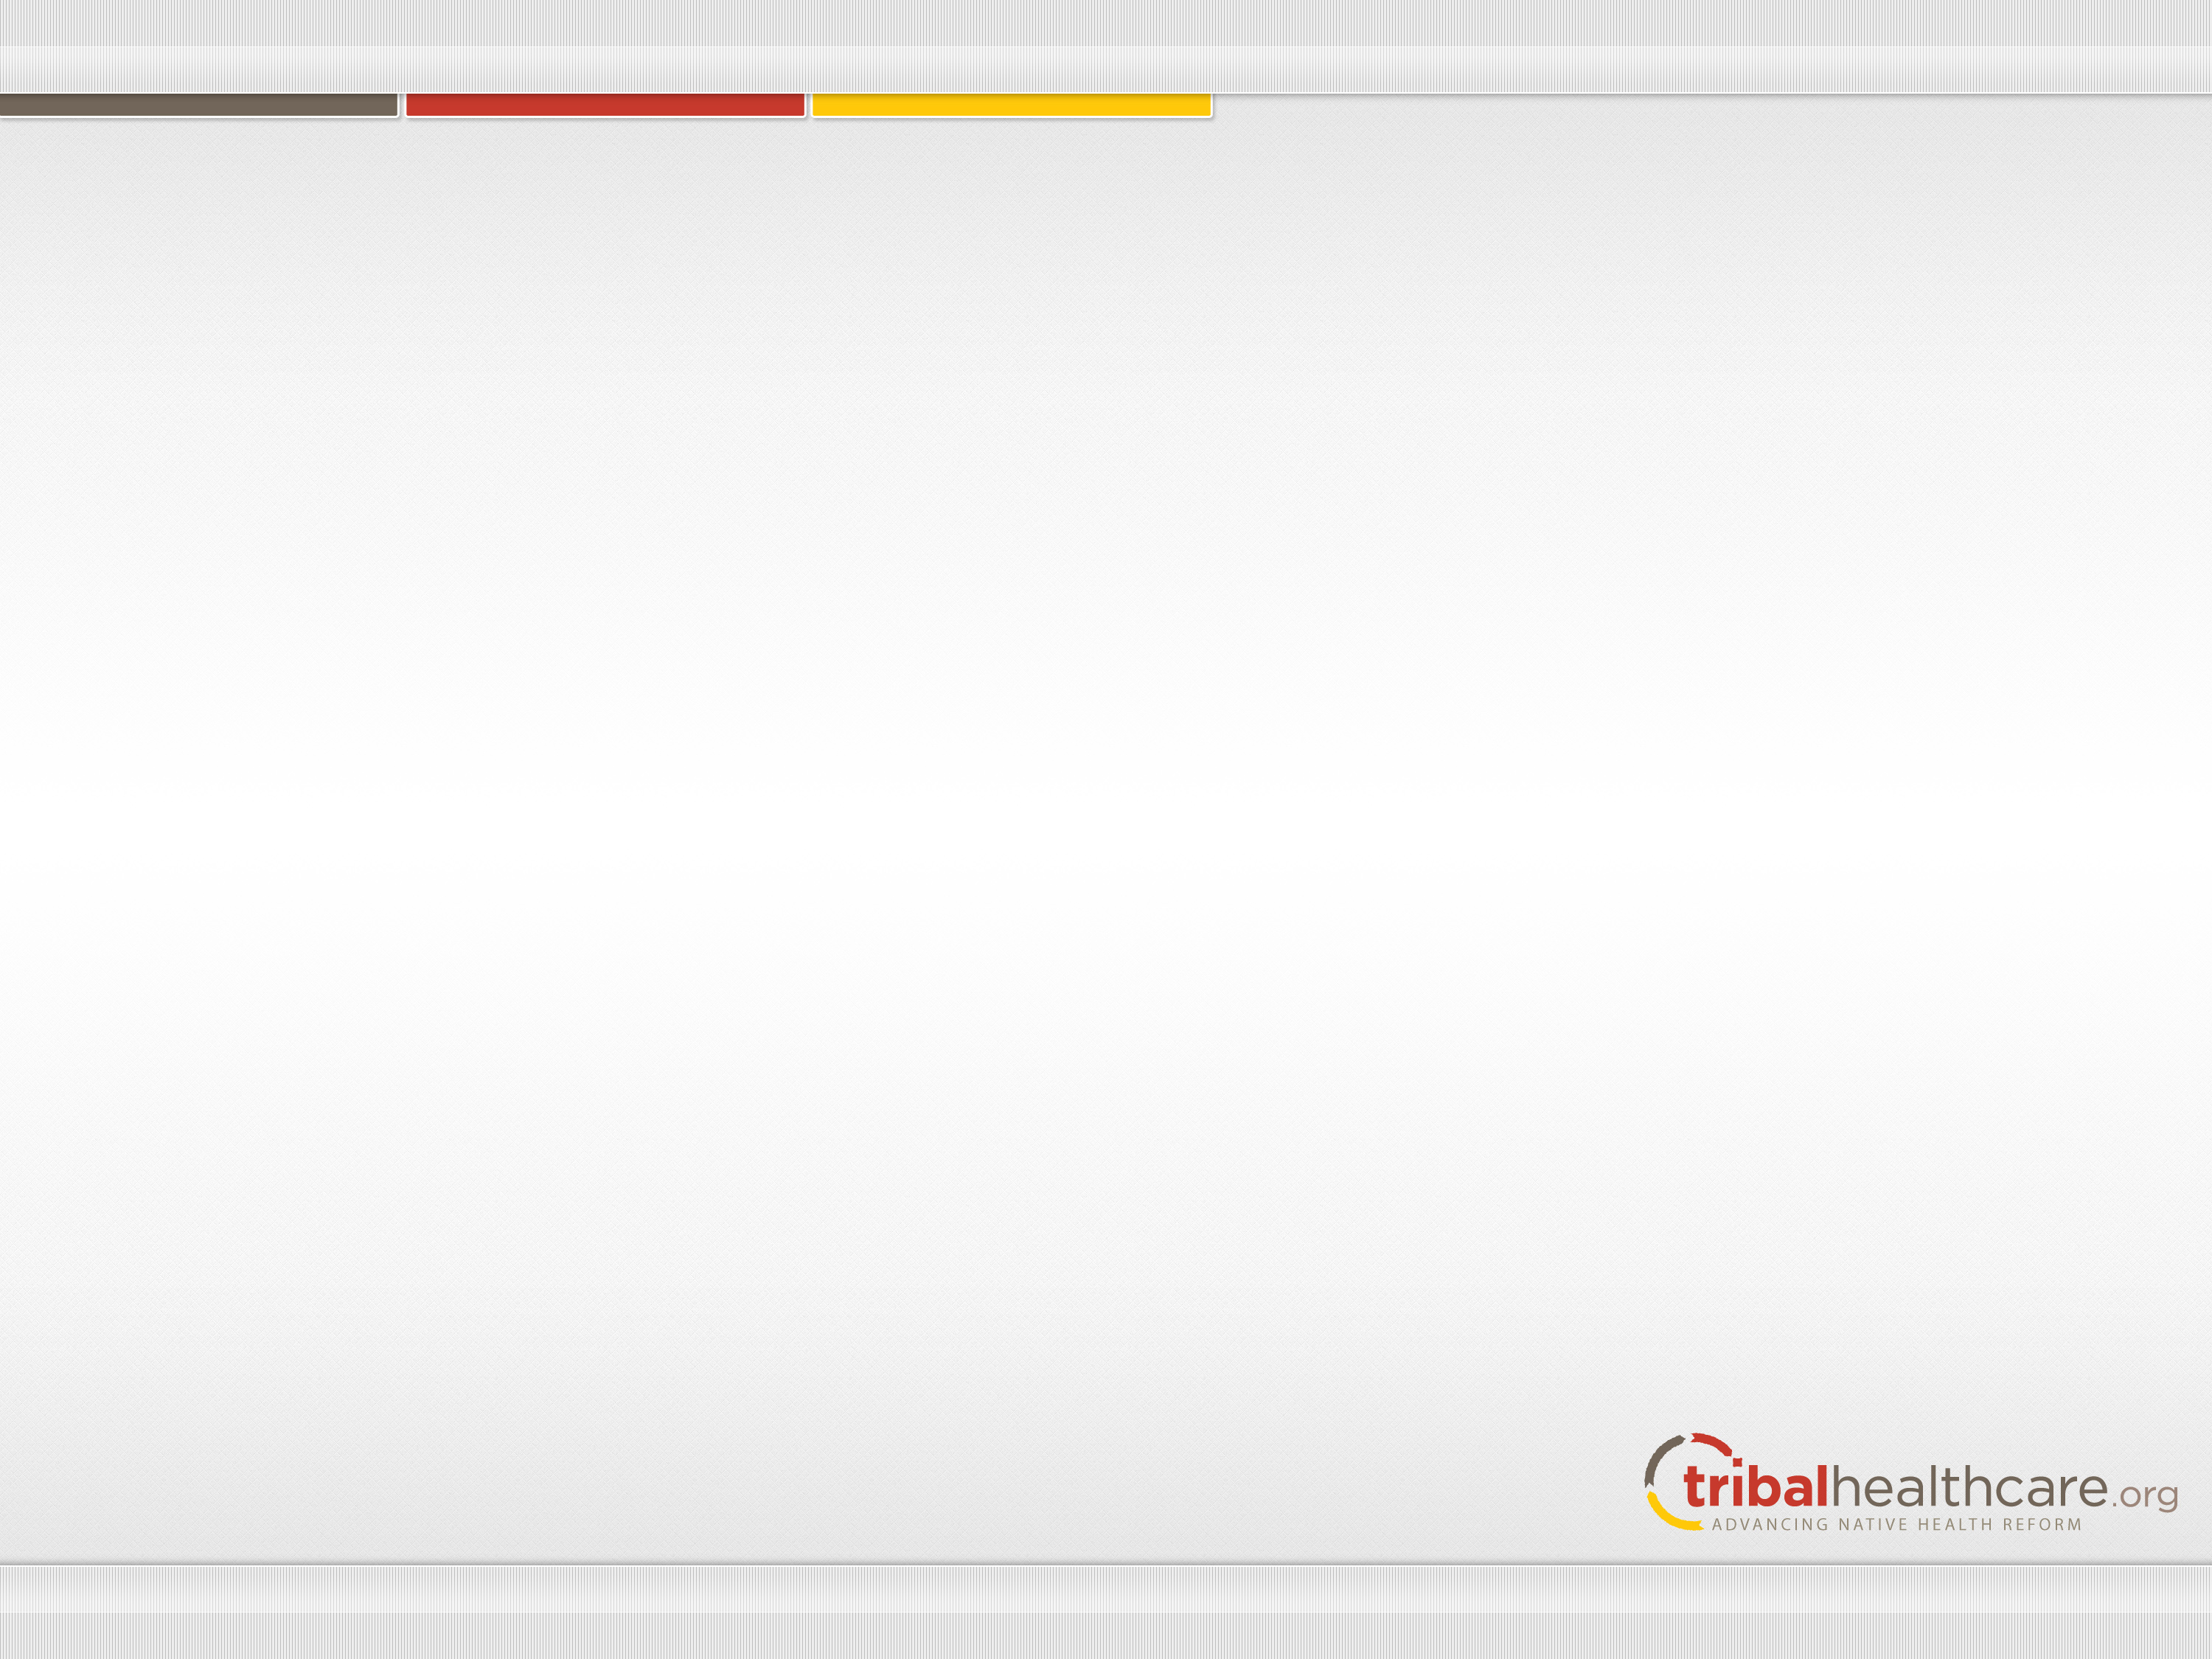
Notes:
Here is a copy of the Form 8965, we will review more the sections on this form. You will claim or report coverage exemptions on Form 8965, Health Coverage Exemptions, and attach it to Form 1040, Form 1040A, or Form 1040EZ. These forms can all be filed electronically. For more information on Form 8965, see the instructions. For any month that you or your dependents do not have coverage or qualify for an exemption, you will have to make a shared responsibility payment. See our Individual Shared Responsibility Provision – Reporting and Calculating the Payment page for more information about the payment.
How you get a coverage exemption depends on the type of exemption. You can obtain some exemptions only from the Marketplace while others may be claimed when you file your tax return. Some exemptions can be obtained from the Marketplace or claimed on your tax return.

Slide 25
The Instructions and the 8965 form can be found at the link below:
http://www.irs.gov/file_source/pub/irs-access/f8965_accessible.pdf

Slide 26
Marketplace Exemptions
If you are granted a coverage exemption from the Marketplace, they will send you a notice with your unique Exemption Certificate Number or ECN. Keep this notice with other important tax information.
You will enter your ECN in Part I, Marketplace-Granted Coverage Exemptions for Individuals, of Form 8965 in column C.
If the Marketplace hasn’t processed your exemption application before you file your tax return, complete Part I of Form 8965 and enter “pending” in Column C for each person listed. If you claim the exemption on your return, you do not need an ECN from the Marketplace.

Slide 27
Other coverage exemptions may be claimed on your tax return using Part III, Coverage Exemptions for Individuals Claimed on Your Return, of Form 8965. Use a separate line for each individual and exemption type claimed on the return.
This chart shows the types of exemptions available and whether they must be granted by the Marketplace, claimed on an income tax return filed with the IRS, or either may be granted by the Marketplace or claimed on a tax return. For additional information about how to get exemptions that may be granted by the Marketplace, visit HealthCare.gov/exemptions.

Slide 28
Second Option – Submit an Exemption Application
OMB Form No. 0938-1190
Approved and released on December 23, 2013
Includes 2 categories of exemptions:
  American Indian / Alaska Native
    Membership in a federally recognized Tribe or Alaska Native Claims Settlement Act (“ANCSA”) Corporation /All other individuals
Notes:
We have one form that serves two categories of the Exemption Waiver Application for American Indians And Alaska Natives and other individuals who are eligible to receive Services from an Indian Health Care Provider. You are eligible to file this exemption if you are in one of the following categories: A member of an Indian Tribe or Another Individual who’s eligible for health services though the Indian Health Service, Tribes and Tribal organizations or an urban clinic . Both Exemptions are lifetime exemptions—it is good for the rest of the persons life. However, in certain circumstances , the exemption is limited. For example , a woman who is pregnant with a child of an eligible Indian can file for an exemption, but is only temporary through post partum (6 weeks after delivering the child) .

Slide 29
Two Categories of Exemptions for AI/AN
The Exemption for Members of an Indian Tribe, for individuals eligible for I/T/U services
Or, for other Individuals who are Eligible to Receive Services from an Indian Health Care Provider
Notes:
There are two categories of Exemptions that AI/AN can file through the Marketplace. You may hear terms like: “Indian Exemption” or “Hardship Waiver” form. The official name for this form is called the Application for American Indians And Alaska Natives and other individuals who are eligible to receive Services from an Indian Health Care Provider. Based on your status or eligibility will determine how you file the form. There are other applications for other categories of Exemptions. You can visit www.marketplace.gov to see the list.

Slide 30
Notes:
Here is a glance at the American Indian and Alaska Native and other Individuals who are eligible to receive services from an Indian Health Care Provider Exemption form. It has been updated and approved on 10/2014. The form is online on the marketplace and can be filled in and then printed out and mailed. The Criteria for eligibility to file this form is listed on page 5. And it also states what documentation needs to sent in with the paper application. We have handed out copies of this form to you and we will show you how to fill it out and answer any questions you may have about the form. But now let’s keep reviewing the process.

Slide 31
Learn More About Exemptions
Health Insurance Marketplace – www.healthcare.gov
Internal Revenue Service –
www.irs.gov

Slide 32

Contact NIHB
Dawn M. Coley
Director of Tribal Health Care Reform Outreach and Education
Phone: 202-507-4078
Email: dcoley@nihb.org
Web: www.nihb.org/tribalhealthreform

